Slide 1
Agent-Based Modeling of the Ductal Structure in Pancreatic Precancer
Cameron Yeagle
Advisors: Dr. Daniel Bergman and Dr. Elana Fertig
Notes:
Hi everyone and thank you for being here at my thesis presentation, I will be talking today about my phd work on machine learning and computational modeling for genomics data, specifically genomics data from pancreatic ductal adenocarcinoma

Slide 2
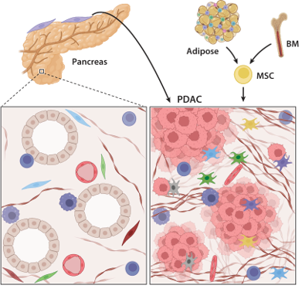
PDAC: Pancreatic Ductal Adenocarcinoma
% of All Cancer Deaths (NCI)
8.4%
5-year Survival Rate (2015-2021)
13.3%
Desmoplastic tumor microenvironment is a hallmark of PDAC
Notes:
Pancreatic Ductal Adenocarcinoma is the most common subtype of pancreatic cancer, constituting about 90% of all pancreatic cancer. PDAC is the third leading cause of cancer-related deaths in the U.S., with a 5-year survival rate of only 13.3%. It is also known to have extremely poor prognosis, with nearly 90% of tumors already metastasized at diagnosis.
PDAC forms in the epithelial cells lining the pancreatic ducts, which are normally responsible for regulating secretion of digestive enzymes into the small intestine. In PDAC, these cells acquire mutations that cause them to proliferate uncontrollably and eventually rupture the ductal membrane. After spreading into the stroma, cancer-associated fibroblasts develop dense networks of collogen fibers, known as desmoplasia, around the previous pancreatic ducts. This creates almost like a shield around the tumor, protecting it from immune attack and drug penetration.
Pancreatic ductal adenocarcinoma is the most common subtype of pancreatic cancer, with a 5 year survival rate of only 13%. The low survival rate is thought to be due to multiple challenges to treatment such as the difficulty of detecting PDAC before it has metastasized. (add graphic) A hallmark of PDAC is what’s called a “desmoplastic” tumor microenvironment. Compared to healthy tissue on the left, PDAC on the right has masses of cell growth in places that used to be healthy ducts, and is infiltrated by a greater diversity of immune and stromal cells while being crisscrossed and encapsulated in this network of collagen fibers, which are deposited by cancer-associated fibroblasts. The dense fibrotic network of collagen is referred to as desmoplasia and is seen in certain types of tumors.
Those immune cells that are found in this microenvironment are often suppressive such as T regulatory cells and suppressive macrophages. Some of the immune cells are “residents” that were probably there in the healthy tissue, but others are recruited from the periphery (BM+blood)

Slide 3
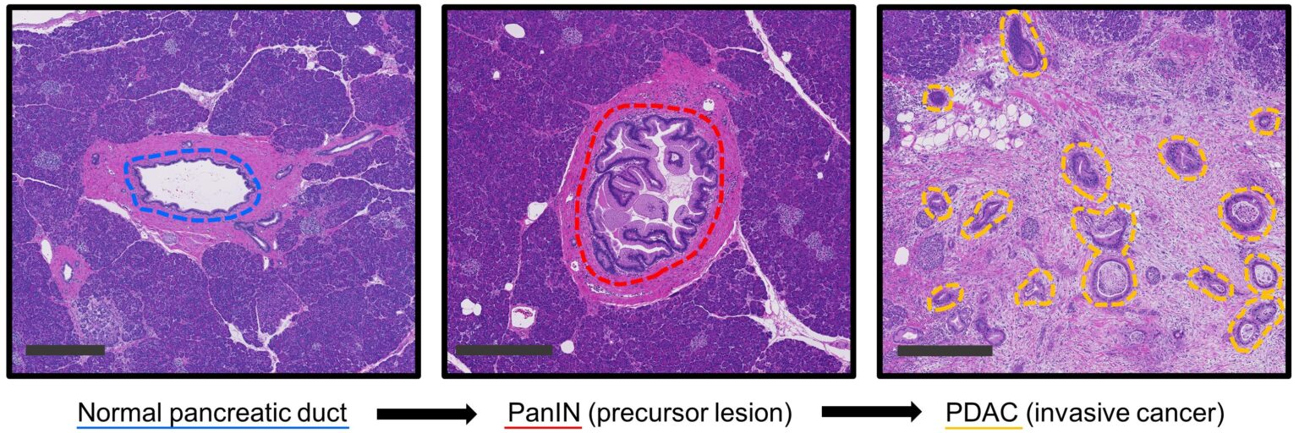
Project Goal: Model Ductal Structure
Model the evolution of the pancreatic ducts
Kiemen A, Wu PH, Braxton AM, Cornish TC, Hruban RH, Wood LD, et al. Power‑law growth models explain incidences and sizes of pancreatic cancer precursor lesions and confirm spatial genomic findings. Sci Adv. 2024 Jul 26;10(30):eado5103. DOI: https://doi.org/10.1126/sciadv.ado5103.
Notes:
Before developing into PDAC, the pancreatic ducts evolve into precancerous lesions (most commonly PanINs). In principle, detecting these lesions early allows for the opportunity for therapeutic intervention. However, these lesions common in the aging pancreas, with only a small subset progressing into PDAC. Hence, understanding the specific alterations in the precancer development is important (this could be better).
In PanINs, ductal epithelial cells undergo unregulated proliferation, forming papillary like structures lumen of the duct.
So for this project, the question we wanted ask was can we model this evolution of the pancreatic ducts prior to it’s develop into PDAC. This would allow us to better understand which lesions or cellular environments promote the progression to cancer.

Slide 4

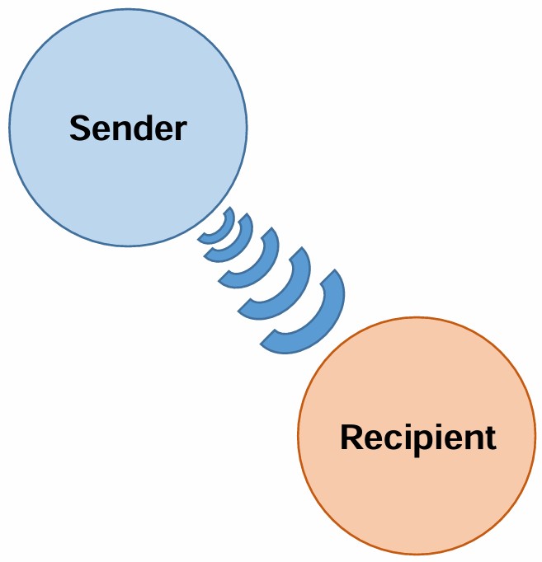
Agent-Based Modeling: PhysiCell
Each cell is an independent agent
Individual States
Independent processes
Cells interact through signals
A. Ghaffarizadeh, R. Heiland, S.H. Friedman, S.M. Mumenthaler, and P. Macklin, PhysiCell: an open source physics-based cell simulator for 3-D multicellular systems, PLoS Comput. Biol. 14(2): e1005991 (2018). DOI: 10.1371/journal.pcbi.1005991.
Notes:
Cells can secrete or consume chemical substrates.
Signals drive changes in behavior: An epithelial cell (sender) exerts pressure (signal) that decreases cycle entry (response) in another epithelial cell (recipient)

Slide 5
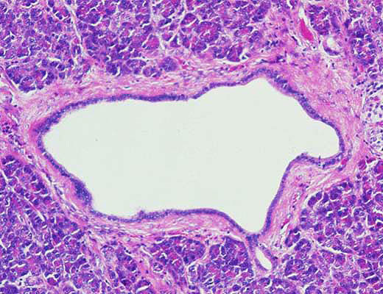
Modeling Challenges
Build cell-to-membrane interactions
Membrane is a dynamic structure
Hruban RH, Adsay NV, Albores-Saavedra J, Compton C, Garrett E, Goodman SN, Kern SE, Klimstra DS, Kloppel G, Longnecker DS, Luttges J, Offerhaus GJA. Pancreatic intraepithelial neoplasia (PanIN): A New nomenclature and classification system for pancreatic duct lesions. Am J Surg Pathol, 2001, volume 25:579-86
Notes:
Before developing into PDAC, the pancreatic ducts evolve into precancerous lesions (most commonly PanINs). In principle, detecting these lesions early allows for the opportunity for therapeutic intervention. However, these lesions common in the aging pancreas, with only a small subset progressing into PDAC. Hence, understanding the specific alterations in the precancer development is important (this could be better).
So for this project, the question we wanted ask was can we model this evolution of the pancreatic ducts prior to it’s develop into PDAC. This would allow us to better understand which lesions or cellular environments promote the progression to cancer.
Imagine you have point in the middle of the duct. The membrane of the duct would be pulling the cell towards it, because that force is what keeps the epithelial cells lining the duct. But the duct cell would also be pulling on the duct, which creates the column like structure we see in PanINs.

Slide 6


Level-Set Method
The ductal region Ω and the basement membrane $Γ=∂Ω$ are defined implicitly by a signed distance function $φ$,
Notes:
Imagine you have a map of the pancreatic tissue. The level-set method works by assigning a number to every single point on this map based on its location relative to the duct's boundary

Slide 7


Handling Deformations
$∀$ point $x(t)$ on $Γ, φ\left(x\left(t\right),t\right)=0$must hold for all time, i.e. $\frac{∂φ}{∂t}=0$. Hence, by the multi-variable chain rule,
$$\frac{dφ}{dt}=\frac{∂φ}{∂t}+∇φ ⋅\frac{dx}{dt}=\frac{∂φ}{∂t}+∇φ⋅V$$
Let $\tilde{V}=V⋅n,$where n is the unit normal vector $\frac{∇φ}{\left|∇φ\right|}$. Then,
$$=\frac{∂φ}{∂t}+\tilde{V}\left|∇φ\right|=0$$
Notes:
∂𝜙/∂t: This part represents how our map changes at a fixed point in time. It's the "update" to our map that we need to calculate.
V: This is the speed at which the boundary is moving at that point.
|∇𝜙|: This part represents the direction the boundary is moving (straight out, perpendicular to the shoreline).
So, the equation simply says: The rate we update our map (∂𝜙/∂t) must be equal to the negative of the speed (V) at which the boundary is moving.

Slide 8
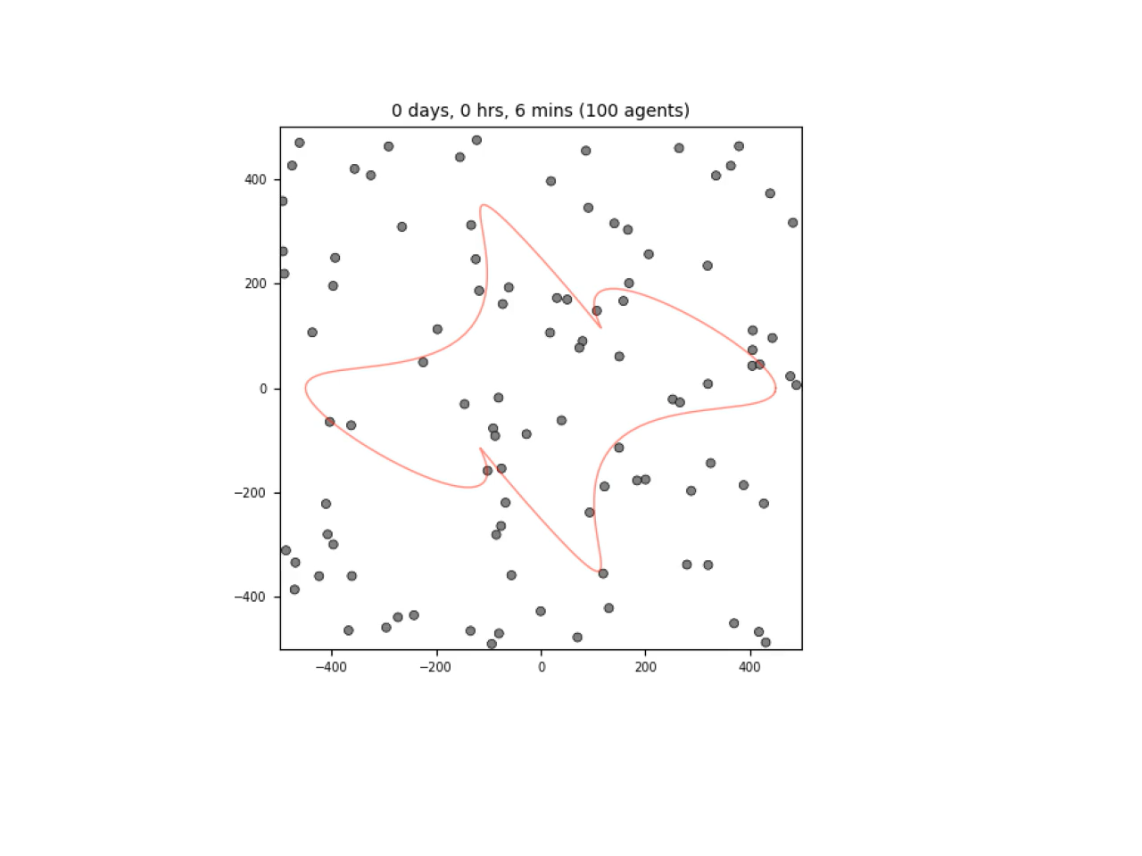
Results: Cell-BM Interactions
Notes:
Pancreatic Ductal Adenocarcinoma is the most common subtype of pancreatic cancer, constituting about 90% of all pancreatic cancer. PDAC is the third leading cause of cancer-related deaths in the U.S., with a 5-year survival rate of only 13.3%. It is also known to have extremely poor prognosis, with nearly 90% of tumors already metastasized at diagnosis.
PDAC begins in the epithelial cells lining the pancreatic ducts, which are normally responsible for regulating secretion of digestive enzymes into the small intestine. In PDAC, these cells acquire mutations that cause them to proliferate uncontrollably and eventually rupture the ductal membrane. After spreading into the stroma, cancer-associated fibroblasts develop dense networks of collogen fibers, known as desmoplasia, around the previous pancreatic ducts. This creates almost like a shield around the tumor, protecting it from immune attack and drug penetration.
Pancreatic ductal adenocarcinoma is the most common subtype of pancreatic cancer, with a 5 year survival rate of only 13%. The low survival rate is thought to be due to multiple challenges to treatment such as the difficulty of detecting PDAC before it has metastasized. (add graphic) A hallmark of PDAC is what’s called a “desmoplastic” tumor microenvironment. Compared to healthy tissue on the left, PDAC on the right has masses of cell growth in places that used to be healthy ducts, and is infiltrated by a greater diversity of immune and stromal cells while being crisscrossed and encapsulated in this network of collagen fibers, which are deposited by cancer-associated fibroblasts. The dense fibrotic network of collagen is referred to as desmoplasia and is seen in certain types of tumors.
Those immune cells that are found in this microenvironment are often suppressive such as T regulatory cells and suppressive macrophages. Some of the immune cells are “residents” that were probably there in the healthy tissue, but others are recruited from the periphery (BM+blood)

Slide 9
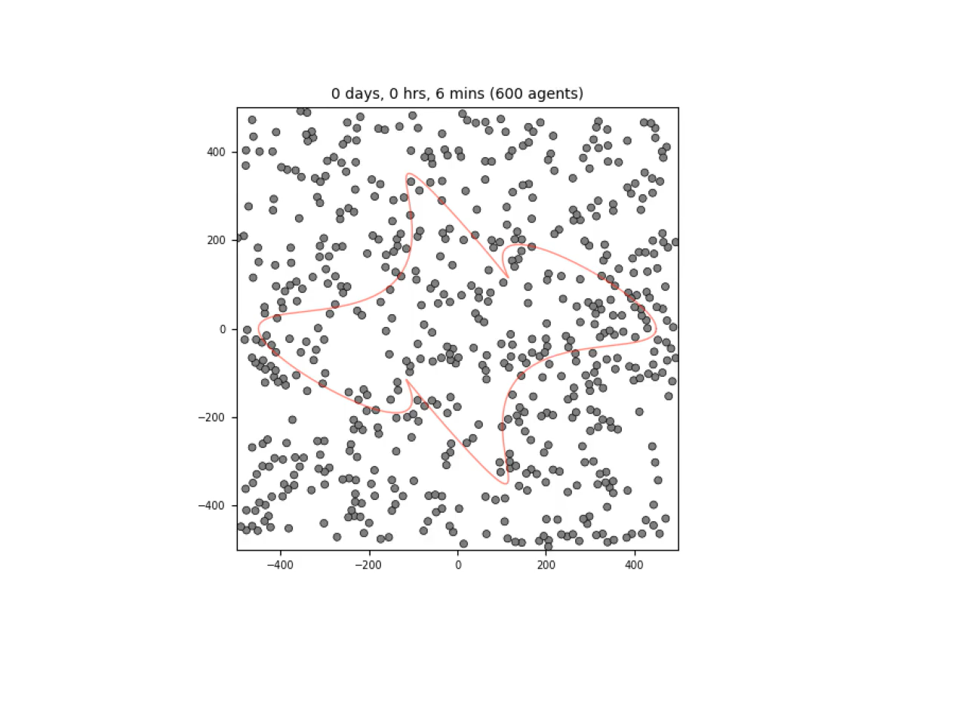
Results: Cell-BM Interactions
Notes:
Pancreatic Ductal Adenocarcinoma is the most common subtype of pancreatic cancer, constituting about 90% of all pancreatic cancer. PDAC is the third leading cause of cancer-related deaths in the U.S., with a 5-year survival rate of only 13.3%. It is also known to have extremely poor prognosis, with nearly 90% of tumors already metastasized at diagnosis.
PDAC begins in the epithelial cells lining the pancreatic ducts, which are normally responsible for regulating secretion of digestive enzymes into the small intestine. In PDAC, these cells acquire mutations that cause them to proliferate uncontrollably and eventually rupture the ductal membrane. After spreading into the stroma, cancer-associated fibroblasts develop dense networks of collogen fibers, known as desmoplasia, around the previous pancreatic ducts. This creates almost like a shield around the tumor, protecting it from immune attack and drug penetration.
Pancreatic ductal adenocarcinoma is the most common subtype of pancreatic cancer, with a 5 year survival rate of only 13%. The low survival rate is thought to be due to multiple challenges to treatment such as the difficulty of detecting PDAC before it has metastasized. (add graphic) A hallmark of PDAC is what’s called a “desmoplastic” tumor microenvironment. Compared to healthy tissue on the left, PDAC on the right has masses of cell growth in places that used to be healthy ducts, and is infiltrated by a greater diversity of immune and stromal cells while being crisscrossed and encapsulated in this network of collagen fibers, which are deposited by cancer-associated fibroblasts. The dense fibrotic network of collagen is referred to as desmoplasia and is seen in certain types of tumors.
Those immune cells that are found in this microenvironment are often suppressive such as T regulatory cells and suppressive macrophages. Some of the immune cells are “residents” that were probably there in the healthy tissue, but others are recruited from the periphery (BM+blood)

Slide 10
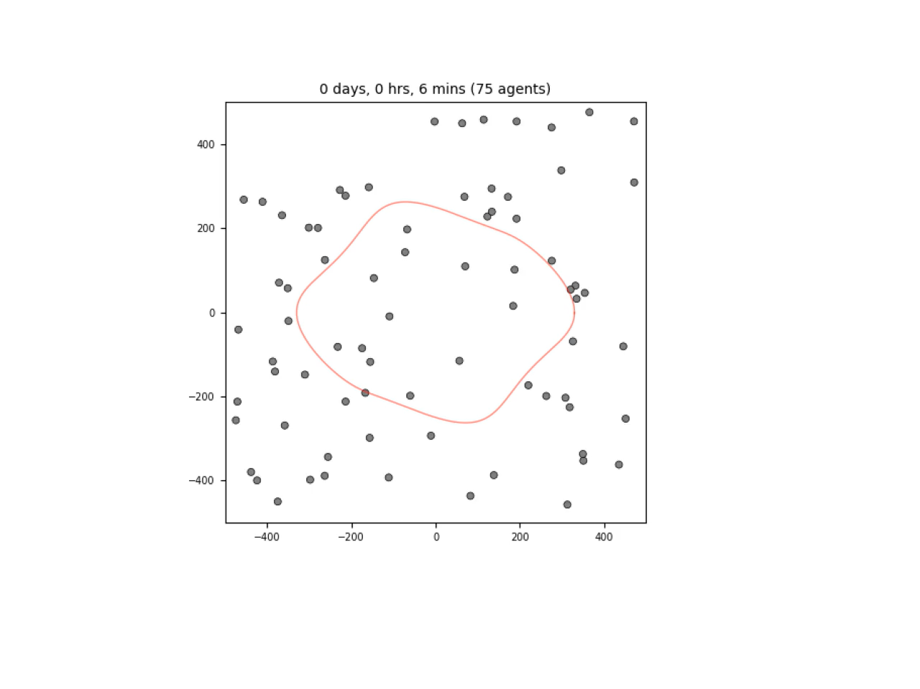
Results: Cell-BM Interactions
Notes:
Pancreatic Ductal Adenocarcinoma is the most common subtype of pancreatic cancer, constituting about 90% of all pancreatic cancer. PDAC is the third leading cause of cancer-related deaths in the U.S., with a 5-year survival rate of only 13.3%. It is also known to have extremely poor prognosis, with nearly 90% of tumors already metastasized at diagnosis.
PDAC begins in the epithelial cells lining the pancreatic ducts, which are normally responsible for regulating secretion of digestive enzymes into the small intestine. In PDAC, these cells acquire mutations that cause them to proliferate uncontrollably and eventually rupture the ductal membrane. After spreading into the stroma, cancer-associated fibroblasts develop dense networks of collogen fibers, known as desmoplasia, around the previous pancreatic ducts. This creates almost like a shield around the tumor, protecting it from immune attack and drug penetration.
Pancreatic ductal adenocarcinoma is the most common subtype of pancreatic cancer, with a 5 year survival rate of only 13%. The low survival rate is thought to be due to multiple challenges to treatment such as the difficulty of detecting PDAC before it has metastasized. (add graphic) A hallmark of PDAC is what’s called a “desmoplastic” tumor microenvironment. Compared to healthy tissue on the left, PDAC on the right has masses of cell growth in places that used to be healthy ducts, and is infiltrated by a greater diversity of immune and stromal cells while being crisscrossed and encapsulated in this network of collagen fibers, which are deposited by cancer-associated fibroblasts. The dense fibrotic network of collagen is referred to as desmoplasia and is seen in certain types of tumors.
Those immune cells that are found in this microenvironment are often suppressive such as T regulatory cells and suppressive macrophages. Some of the immune cells are “residents” that were probably there in the healthy tissue, but others are recruited from the periphery (BM+blood)

Slide 11
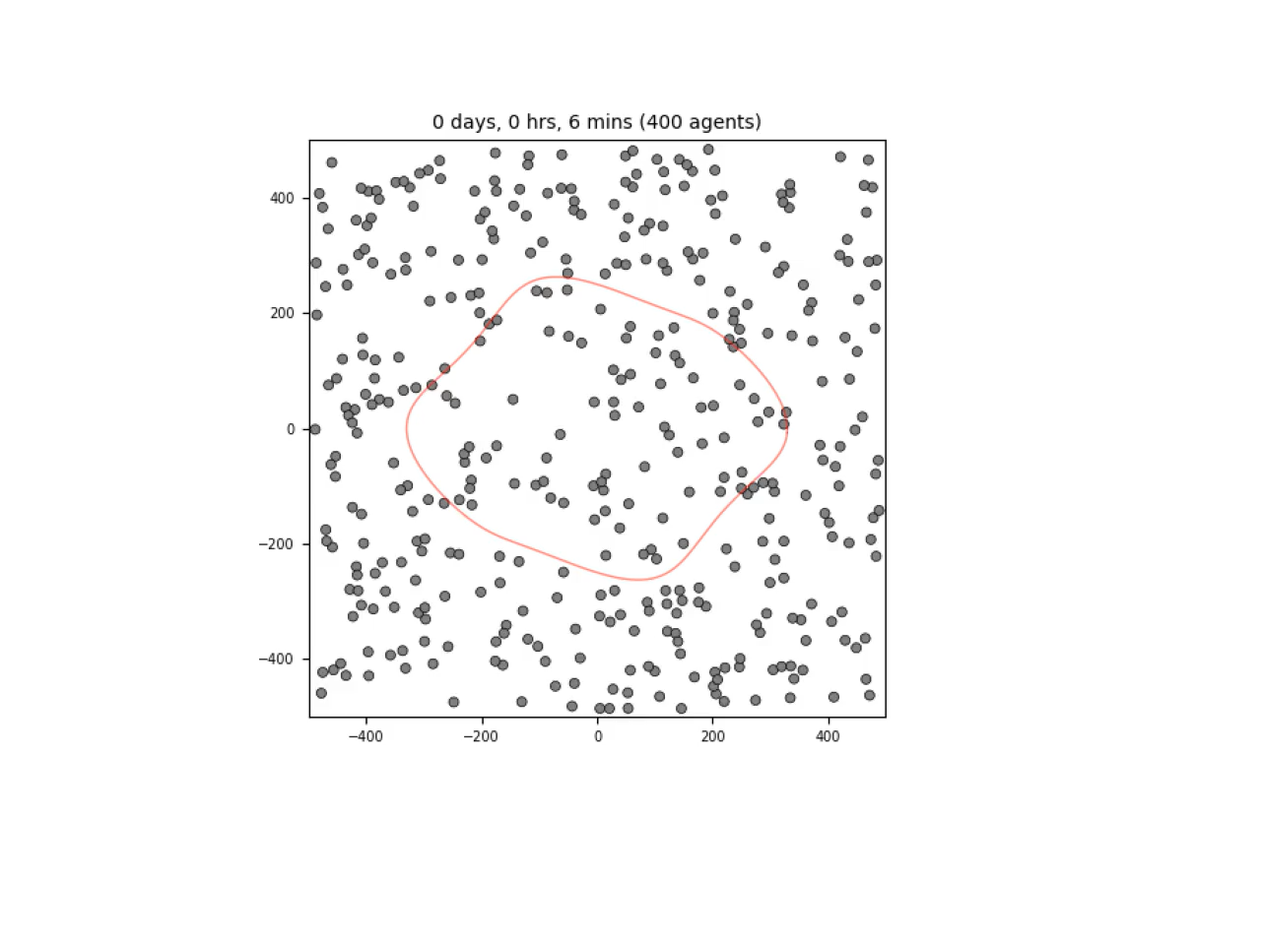
Results: Cell-BM Interactions
Notes:
Pancreatic Ductal Adenocarcinoma is the most common subtype of pancreatic cancer, constituting about 90% of all pancreatic cancer. PDAC is the third leading cause of cancer-related deaths in the U.S., with a 5-year survival rate of only 13.3%. It is also known to have extremely poor prognosis, with nearly 90% of tumors already metastasized at diagnosis.
PDAC begins in the epithelial cells lining the pancreatic ducts, which are normally responsible for regulating secretion of digestive enzymes into the small intestine. In PDAC, these cells acquire mutations that cause them to proliferate uncontrollably and eventually rupture the ductal membrane. After spreading into the stroma, cancer-associated fibroblasts develop dense networks of collogen fibers, known as desmoplasia, around the previous pancreatic ducts. This creates almost like a shield around the tumor, protecting it from immune attack and drug penetration.
Pancreatic ductal adenocarcinoma is the most common subtype of pancreatic cancer, with a 5 year survival rate of only 13%. The low survival rate is thought to be due to multiple challenges to treatment such as the difficulty of detecting PDAC before it has metastasized. (add graphic) A hallmark of PDAC is what’s called a “desmoplastic” tumor microenvironment. Compared to healthy tissue on the left, PDAC on the right has masses of cell growth in places that used to be healthy ducts, and is infiltrated by a greater diversity of immune and stromal cells while being crisscrossed and encapsulated in this network of collagen fibers, which are deposited by cancer-associated fibroblasts. The dense fibrotic network of collagen is referred to as desmoplasia and is seen in certain types of tumors.
Those immune cells that are found in this microenvironment are often suppressive such as T regulatory cells and suppressive macrophages. Some of the immune cells are “residents” that were probably there in the healthy tissue, but others are recruited from the periphery (BM+blood)

Slide 12
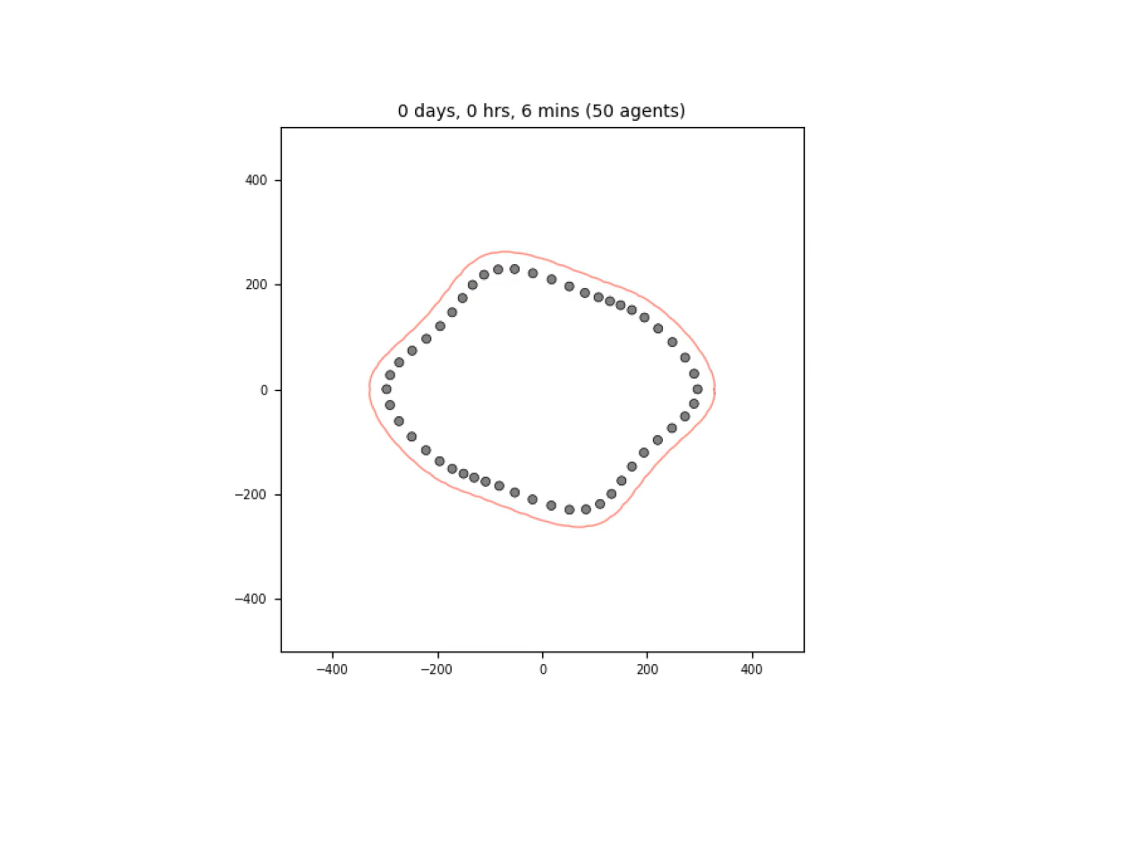
Results: Deformations
Notes:
Pancreatic Ductal Adenocarcinoma is the most common subtype of pancreatic cancer, constituting about 90% of all pancreatic cancer. PDAC is the third leading cause of cancer-related deaths in the U.S., with a 5-year survival rate of only 13.3%. It is also known to have extremely poor prognosis, with nearly 90% of tumors already metastasized at diagnosis.
PDAC begins in the epithelial cells lining the pancreatic ducts, which are normally responsible for regulating secretion of digestive enzymes into the small intestine. In PDAC, these cells acquire mutations that cause them to proliferate uncontrollably and eventually rupture the ductal membrane. After spreading into the stroma, cancer-associated fibroblasts develop dense networks of collogen fibers, known as desmoplasia, around the previous pancreatic ducts. This creates almost like a shield around the tumor, protecting it from immune attack and drug penetration.
Pancreatic ductal adenocarcinoma is the most common subtype of pancreatic cancer, with a 5 year survival rate of only 13%. The low survival rate is thought to be due to multiple challenges to treatment such as the difficulty of detecting PDAC before it has metastasized. (add graphic) A hallmark of PDAC is what’s called a “desmoplastic” tumor microenvironment. Compared to healthy tissue on the left, PDAC on the right has masses of cell growth in places that used to be healthy ducts, and is infiltrated by a greater diversity of immune and stromal cells while being crisscrossed and encapsulated in this network of collagen fibers, which are deposited by cancer-associated fibroblasts. The dense fibrotic network of collagen is referred to as desmoplasia and is seen in certain types of tumors.
Those immune cells that are found in this microenvironment are often suppressive such as T regulatory cells and suppressive macrophages. Some of the immune cells are “residents” that were probably there in the healthy tissue, but others are recruited from the periphery (BM+blood)

Slide 13
Future Work
Improve efficiency of reinitialization algorithm
Fast Marching Method
Refine deformation mechanics
Smoother membrane
Notes:
Pancreatic Ductal Adenocarcinoma is the most common subtype of pancreatic cancer, constituting about 90% of all pancreatic cancer. PDAC is the third leading cause of cancer-related deaths in the U.S., with a 5-year survival rate of only 13.3%. It is also known to have extremely poor prognosis, with nearly 90% of tumors already metastasized at diagnosis.
PDAC begins in the epithelial cells lining the pancreatic ducts, which are normally responsible for regulating secretion of digestive enzymes into the small intestine. In PDAC, these cells acquire mutations that cause them to proliferate uncontrollably and eventually rupture the ductal membrane. After spreading into the stroma, cancer-associated fibroblasts develop dense networks of collogen fibers, known as desmoplasia, around the previous pancreatic ducts. This creates almost like a shield around the tumor, protecting it from immune attack and drug penetration.
Pancreatic ductal adenocarcinoma is the most common subtype of pancreatic cancer, with a 5 year survival rate of only 13%. The low survival rate is thought to be due to multiple challenges to treatment such as the difficulty of detecting PDAC before it has metastasized. (add graphic) A hallmark of PDAC is what’s called a “desmoplastic” tumor microenvironment. Compared to healthy tissue on the left, PDAC on the right has masses of cell growth in places that used to be healthy ducts, and is infiltrated by a greater diversity of immune and stromal cells while being crisscrossed and encapsulated in this network of collagen fibers, which are deposited by cancer-associated fibroblasts. The dense fibrotic network of collagen is referred to as desmoplasia and is seen in certain types of tumors.
Those immune cells that are found in this microenvironment are often suppressive such as T regulatory cells and suppressive macrophages. Some of the immune cells are “residents” that were probably there in the healthy tissue, but others are recruited from the periphery (BM+blood)

Slide 14





Acknowledgements
Special thanks to our lab members!
Dr. Elana Fertig
Dr. Daniel Bergman
Dr. Jeanette Johnson
Fellow Interns:
Josh Naranjo
Lynijah Russell

Slide 15
Thank you!
Any Questions?

